Slide 1
24
7
30
Date
Arc Length
EQ – How do I find the length of an arc?
What is an arc?
An arc is a portion of the circumference of a circle.
How do I find the length of an arc?
Remember the formula to find circumference of a circle?
C = 2 x π x r
Where C= Circumference and r= radius of the circle
7

Slide 2
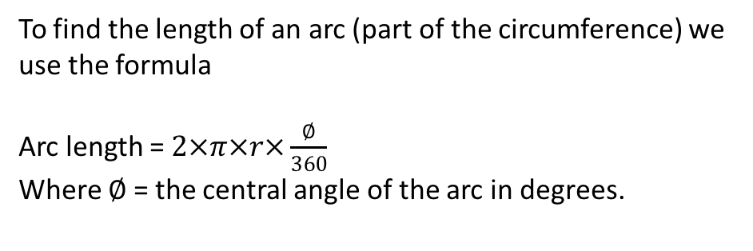
24
7
30
Date
Arc Length
EQ – How do I find the length of an arc?
How do I find the length of an arc?
Remember the formula to find circumference of a circle?
C = 2 x π x r
Where C= Circumference and r= radius of the circle
To find the length of an arc (part of the circumference) we use the formula
Arc length = $2×π×r×\frac{∅}{360}$
Where $∅$ = the central angle of the arc in degrees.
7

Slide 3
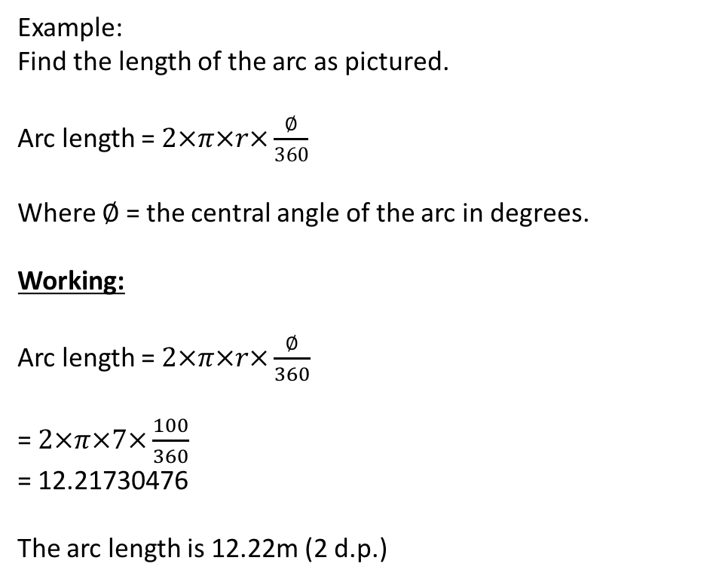
24
7
30
Date
Arc Length
EQ – How do I find the length of an arc?
How do I find the length of an arc?
Example:
Find the length of the arc as pictured.
Arc length = $2×π×r×\frac{∅}{360}$
Where $∅$ = the central angle of the arc in degrees.
Working:
Arc length = $2×π×r×\frac{∅}{360}$
= $2×π×7×\frac{100}{360}$
= 12.21730476
The arc length is 12.22m (2 d.p.)
7

Slide 4
Task
Complete the exercise on P147 of your text.
Make sure you show all working out.

Slide 5
Notes Review
24, 7 ,30
Date
Title
Essential question
Notes complete
Notes complete with colour and diagrams
Questions completed
Contents page filed in
Formula page filled in

Slide 6
Homework
Review your notes and write a summary answering the essential question.

